Slide 1
Software Testing and Quality Assurance (CST-311)
Department:- Computer Science & Engineering
Unit -2
Chapter 1
Lecture 1.1

Slide 2
Contents
Test Case
Test case Template
Characteristics of Good Test Case
Test Suite
Test Case Design
Test Case Design-An Example
Test case Design Techniques

Slide 3
Test Case
A TEST CASE is a set of conditions or variables under which a tester will determine whether a system under test satisfies requirements or works correctly.
The process of developing test cases can also help find problems in the requirements or design of an application.

Slide 4
Test Case Template
Test Suite ID | The ID of the test suite to which this test case belongs.
Test Case ID | The ID of the test case.
Test Case Summary | The summary / objective of the test case.
Related Requirement | The ID of the requirement this test case relates/traces to.
Prerequisites | Any prerequisites or preconditions that must be fulfilled prior to executing the test.
Test Procedure | Step-by-step procedure to execute the test.
Test Data | The test data, or links to the test data, that are to be used while conducting the test.
Expected Result | The expected result of the test.
Actual Result | The actual result of the test; to be filled after executing the test.
Status | Pass or Fail. Other statuses can be ‘Not Executed’ if testing is not performed and ‘Blocked’ if testing is blocked.
Remarks | Any comments on the test case or test execution.
Created By | The name of the author of the test case.
Date of Creation | The date of creation of the test case.
Executed By | The name of the person who executed the test.
Date of Execution | The date of execution of the test.
Test Environment | The environment (Hardware/Software/Network) in which the test was executed.

Slide 5
Characteristics of a Good Test Case
Accurate: Exacts the purpose.
Economical: No unnecessary steps or words.
Traceable: Capable of being traced to requirements.
Repeatable: Can be used to perform the test over and over.
Reusable: Can be reused if necessary.

Slide 6
Test Suite
Test suite is a container that has a set of tests which helps testers in executing and reporting the test execution status. It can take any of the three states namely Active, In progress and completed.
A Test case can be added to multiple test suites and test plans. After creating a test plan, test suites are created which in turn can have any number of tests.
Test suites are created based on the cycle or based on the scope. It can contain any type of tests, viz - functional or Non-Functional.

Slide 7
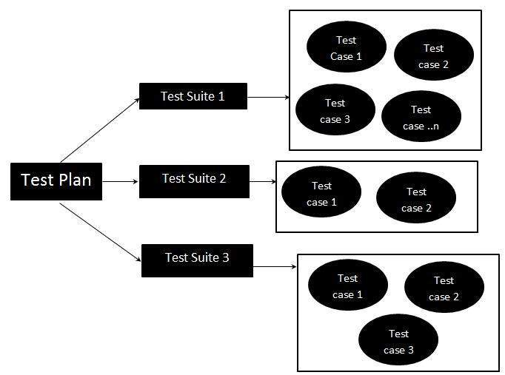
Test Suite - Diagram

Slide 8
Test Case Example
Let's assume that you are testing the login functionality of any web application, say Facebook.
Next two slides shows the Test Cases for the same:

Slide 9
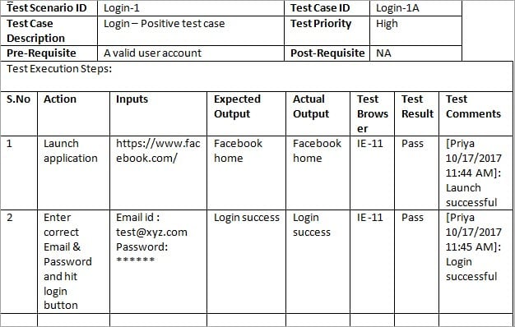
Test Case Example

Slide 10
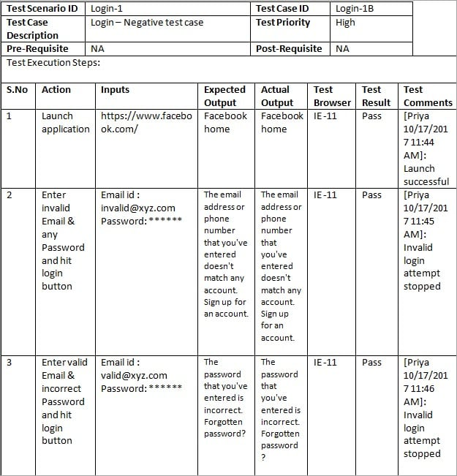
Test Case Example

Slide 11
Test Case Design
Test case design refers to how you set-up your test cases.
It is important that your tests are designed well, or you could fail to identify bugs and defects in your software during testing.
There are many different test case design techniques used to test the functionality and various features of your software.
Designing good test cases ensure that every aspect of your software gets tested so that you can find and fix any issues.

Slide 12
Test case Design: An Example
Title: Login to the website or app
Description: User should be able to successfully log in to their account on the website/app
Preconditions: User must already be registered and use their correct login details
Assumptions: They are using a supported device or browser to log in
Test Steps:
1. Open website or app
2. Enter the username and password in the appropriate fields
3. Click “login”
Expected Result: The user should log in successfully.

Slide 13
Test case Design Technique
The main purpose of test case design techniques is to test the functionalities and features of the software with the help of effective test cases. The test case design techniques are broadly classified into three major categories.
1. Specification-Based techniques or Black-Box techniques
2. Structure-Based techniques or White-Box techniques
3. Experience-Based techniques

Slide 14
Summary
A good Test case should be accurate, economical, traceable, repeatable and reusable.
Test suite is a container that has a set of tests which helps testers in executing and reporting the test execution status.
The main purpose of test case design techniques is to test the functionalities and features of the software with the help of effective test cases.

Slide 15
References
Text Books:
CemKaner, Jack Falk, HungQuoc Nguyen, Testing Computer Software, Wiley, (Second Edition).
William E. Perry,“ Effective Methods for Software Testing”, John Wiley & Sons.
Boris Beizer, ”Software Testing Techniques”, Second Edition, Dreamtech.
Reference Books:
Rex Black, “Managing the Testing Process: Practical Tools and Techniques for Managing Hardware and Software Testing”.
Daniel Galin, “Software Quality Assurance from Theory to Implementation”, Pearson Education.

Slide 16
THANK YOU

